Slide 1







Evaluation of Luxury Hotel Brands: An Image-Based Analysis
Capstone Project Final Review

Slide 2
Group Information
Sr No. | Name | Prn No.
1 | Adnan Nazmuddin | 1032190097
2 | Venkatesh Shirbhate | 1032190785
3 | Sahil Vakkani | 1032191630
4 | Vidushi Sharma | 1032191366
Capstone Project Guide: Dr. Nitin Pise

Slide 3
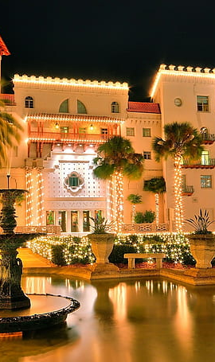
INTRODUCTION
In the realm of luxury hotel management, where consumer preferences and perceptions play a pivotal role, brand managers face the task of capturing and leveraging the essence of their brand to create meaningful connections with customers.
This research project aims to explore the impact of user-generated photos on consumer evaluations of luxury hotel brands, employing advanced techniques in AI, ML, Deep Learning, Image Processing, and Computer Vision to analyze and interpret these visual cues.

Slide 4

Problem Statement
To investigate the attributes that significantly influence consumer evaluations of luxury hotel brands based on user-provided photos and to develop a deep learning-based approach to analyze and interpret these visual cues.
By addressing this problem, the study aims to bridge the gap in understanding the role of visual content in shaping consumer perceptions and provide valuable insights for brand managers to enhance their strategies and elevate guest experiences in the luxury hotel domain.

Slide 5
Literature Review
Sr. No. | Name of Publication | Objective | Approaches | Result | Research Gap
1 | Evaluation of Luxury Hotel Brands: “An Image-Based Analysis" | To explore the factors that drive content creation behavior on social networking sites (SNSs) from a commitment perspective. The researchers aimed to investigate the effects of both affective and normative commitments on content creation behavior. | The researchers collected data through an online survey of 423 SNS users in China. They used structural equation modeling (SEM) to test their proposed model and hypotheses. | The results of the study suggest that both affective and normative commitments have a significant positive effect on content creation behavior on SNSs. Affective commitment, which is the emotional attachment to the SNS, was found to be the strongest predictor of content creation behavior. | Limited scope of image analysis. Regional differences in luxury hotel brand perception Consumer preferences for luxury hotel brands Methodological limitations of image-based analysis Limited sample size

Slide 6
Sr. No. | Name of Publication | Objective | Approaches | Result | Research Gap
2. | The role of self-construal in consumers’ electronic word of mouth (eWOM) in social networking sites: A social cognitive approach. | To explore the role of self-construal in consumers' electronic word of mouth (eWOM) behavior on social networking sites. Specifically, the researchers aimed to investigate the impact of independent and interdependent self-construals on the formation of eWOM intentions, attitudes, and behaviors on SNSs. | Data collection through an online survey of 268 SNS users in South Korea. A social cognitive approach to develop and test their proposed model, which examined the relationships among self-construal, eWOM intentions, and behaviors. Analyzed the data using structural equation modeling (SEM). | Results indicate that both independent and interdependent self-construals have a significant effect on eWOM intentions, attitudes, and behaviors on SNSs. consumers with an independent self-construal were more likely to engage in eWOM behaviors on SNSs than those with an interdependent self-construal. | Limited research on the role of self-construal in eWOM behavior. Limited application of social cognitive theory to eWOM behavior. Limited research on the impact of social networking sites on eWOM behavior Limited research on the moderating effect of culture on the relationship between self-construal and eWOM behavior. Limited research on the impact of eWOM on consumer behavior.

Slide 7
Sr. No. | Name of Publication | Objective | Approaches | Result | Research Gap
3. | Mediating roles of social presence and channel commitment. | To investigate the mediating role of social presence and channel commitment in the relationship between social media engagement and sports channel loyalty. to understand how social media engagement influences sports channel loyalty and to identify the underlying psychological processes that explain this relationship. | Data collection through an online survey of 321 sports fans in South Korea. Use of structural equation modeling (SEM) to test proposed model, which examined the relationships among social media engagement, social presence, channel commitment, and sports channel loyalty. | Social media engagement has a significant positive effect on sports channel loyalty, and this relationship is partially mediated by social presence and channel commitment. Social media engagement has a direct effect on sports channel loyalty. | Need for more research on how social presence and channel commitment influence consumers’ trust and satisfaction in online shopping. Limited research on the effect of channel commitment on consumers’ intention to continue using a particular online shopping channel. Need for more research on how different types of online shopping channels affect consumers’ social presence and channel commitment. Limited research on the moderating effect of culture on the relationship between social presence, channel commitment, and online shopping. Need for more research on how online retailers can enhance social presence and channel commitment to improve consumers’ trust and satisfaction in online shopping.

Slide 8
Sr. No. | Name of Publication | Objective | Approaches | Result | Research Gap
4. | Mahajan and S. Chaudhary, "Categorical Image Classification Based On Representational Deep Network (RESNET)," 2019 3rd International conference on Electronics, Communication and Aerospace Technology (ICECA) | The objective of the research paper titled "Categorical Image Classification Based On Representational Deep Network (RESNET)" is to propose a method for categorical image classification using a deep network based on the ResNet architecture. | The authors utilize the ResNet architecture as the foundation for their deep network model. They develop a categorical image classification framework by training the ResNet model on a dataset of images. The network is trained using a large number of labeled images, allowing it to learn discriminative features and patterns for accurate classification. | The research paper presents the results of the experiments conducted to evaluate the proposed approach. The authors provide details on the performance of the developed categorical image classification system based on the ResNet model. The results include metrics such as accuracy, precision, recall, and F1-score, indicating the effectiveness of the approach in accurately classifying images into different categories. | From the provided information, it is not explicitly mentioned what the specific research gap addressed by the paper is. However, potential research gaps in this context could include: The need for an efficient and accurate categorical image classification method using deep neural networks. The exploration of the performance of the ResNet architecture in image classification tasks. The identification of challenges or limitations in existing image classification approaches that the proposed method aims to overcome.

Slide 9
Sr. No. | Name of Publication | Objective | Approaches | Result | Research Gap
5. | Investigating the ripple effect in virtual communities: An example of Facebook Fan Pages. | To investigate the ripple effect in virtual communities, specifically in the context of Facebook Fan Pages. To understand how user interactions on Fan Pages can create a ripple effect and influence the behavior of other users, | Data collection from 305 Facebook users who were fans of a specific Fan Page. Use of structural equation modeling to test the proposed model, which examined the relationships among user engagement, social norms, social influence, and the ripple effect. | User engagement has a significant positive effect on the ripple effect, and this relationship is partially mediated by social norms and social influence. social norms, which are the perceived expectations of others in the community, mediate the relationship between user engagement and social influence, | Limited research on the ripple effect of virtual communities, especially in the context of Facebook Fan Pages. Need for more research on how different types of content (e.g., text, images, videos) and user interactions (e.g., likes, comments, shares) contribute to the ripple effect in virtual communities. Limited research on the factors that moderate the strength and direction of the ripple effect, such as the size and composition of the virtual community, the type of content, and the level of user engagement. Need for more research on how the ripple effect in virtual communities affects user behaviour and outcomes, such as brand awareness, loyalty, and purchase intention Limited research on the long-term sustainability of the ripple effect in virtual communities and how it evolves over time. Need for more research on how virtual communities can be managed and optimized to enhance the ripple effect and maximize its benefits for users and brands.

Slide 10
Sr. No. | Name of Publication | Objectives | Approaches | Result | Research Gap
6. | Implications of Instagram photography for place branding. Media and Communication. | To explore the implications of Instagram photography for place branding. The researchers aimed to understand how Instagram photography is being used to represent and promote places, and to identify the potential benefits and challenges of this approach to place branding. | A qualitative content analysis of Instagram photographs that were tagged with specific hashtags related to place branding, Analyzed the visual and textual elements of the photographs, as well as the comments and engagement generated by them, to identify common themes and patterns in the representation of places on Instagram. | The researchers found that Instagram photographs are being used to showcase the unique features and attractions of places, as well as to create a sense of community and belonging among residents and visitors. | Limited research on the implications of Instagram photography for place branding, especially in the context of tourism destinations. Need for more research on how Instagram photography affects consumers’ perceptions and attitudes towards places and how it influences their decision-making processes. Limited research on the role of user-generated content in place branding and how it can be used to enhance the authenticity and credibility of place brands Need for more research on the factors that influence the effectiveness of Instagram photography for place branding, such as the type of destination, the characteristics of the target audience, and the style and quality of the photographs.

Slide 11
Sr. No. | Name of Publication | Objectives | Approaches | Result | Research Gap
7. | Investigation of social media marketing: How does the hotel industry in Hong Kong perform in marketing on social media websites? | To investigate the use of social media marketing in the hotel industry in Hong Kong. To understand how hotels in Hong Kong are using social media to promote their products and services, as well as to identify the benefits and challenges of this approach to marketing. | Conducted a survey of 102 hotels in Hong Kong to assess their use of social media marketing. The survey included questions about the types of social media platforms used, the frequency and content of posts, the strategies and tactics employed, and the perceived benefits and challenges of social media marketing. | Study suggests that social media marketing is becoming an increasingly important tool for hotels in Hong Kong to reach and engage with customers. Results show the majority of hotels surveyed (84%) had a presence on at least one social media platform, with Facebook and Twitter being the most commonly used platforms. | Need for more research on the types of social media platforms that hotels in Hong Kong use for marketing purposes, and how they use these platforms to engage with customers and promote their services. Limited research on the role of user-generated content in place branding and how it can be used to enhance the authenticity and credibility of place brands. Need for more research on the factors that influence the effectiveness of Instagram photography for place branding, such as the type of destination, the characteristics of the target audience, and the style and quality of the photographs. Limited research on the impact of Instagram photography on place identity and how it can shape and transform the image over time.

Slide 12
Sr. No. | Name of Publication | Objective | Approaches | Result | Research Gap
8. | Testing the cross-brand and cross-market validity of a consumer based brand equity (CBBE) model for destination brands. | To test the cross-brand and cross-market validity of a Consumer-Based Brand Equity (CBBE) model for destination brands. The study aimed to evaluate the validity of the CBBE model in different markets and for different types of destinations, and to assess its ability to predict destination choice behavior. | Survey of 898 respondents from four different countries (the United States, China, Germany, and the United Kingdom) who had visited a variety of different types of destinations (urban, coastal, and cultural). The survey measured the respondents' perceptions of the brand equity of the destinations they had visited, as well as their destination choice behavior. | The results of the study supported the cross-market and cross-brand validity of the CBBE model for destination brands. The study found that the model was able to predict destination choice behavior across different markets and for different types of destinations. | CBBE model for destination brands is the lack of empirical research that has been conducted to test the validity of existing CBBE models in different contexts.While many CBBE models have been proposed and tested for various product and service categories, there is still a need to investigate whether these models are applicable to destination brands, which have unique characteristics and are subject to different marketing strategies.

Slide 13
Sr. No. | Name of Publication | Objective | Approaches | Result | Research Gap
9. | Influence of integration on interactivity in social media luxury brand communities. | To investigate the influence of integration on interactivity in social media luxury brand communities. The study sought to explore how the integration of different social media platforms (e.g., Facebook, Twitter, Instagram) affects the level of interactivity in luxury brand communities, and how this in turn impacts customer engagement and loyalty. | The study used a survey of 415 participants who were members of luxury brand communities on social media. The survey measured the respondents' perceptions of integration, interactivity, customer engagement, and loyalty. The study used structural equation modeling (SEM) to test the relationships between these variables. | The results of the study showed that integration had a positive impact on interactivity in luxury brand communities. The study found that the use of multiple social media platforms in combination (i.e., high integration) led to higher levels of interactivity than the use of a single platform (i.e., low integration). The study also found that interactivity was positively related to customer engagement and loyalty. | The lack of research that investigates the impact of integration on interactivity in the context of luxury brand communities specifically. While previous studies have explored the relationship between integration and interactivity in social media communities more broadly, there is still a need for research that focuses specifically on luxury brands, which operate in a unique context and face specific challenges and opportunities.

Slide 14
Sr. No. | Name of Publication | Objective | Approaches | Result | Research Gap
10. | Unleashing the power of luxury: Antecedents of luxury brand perception and effects on luxury brand strength | To explore the antecedents of luxury brand perception and their effects on luxury brand strength. To identify the key factors that contribute to the perception of luxury brands and the impact of these perceptions on the brand's strength. | Review existing literature on luxury branding and propose a conceptual framework that outlines the antecedents of luxury brand perception and their impact on brand strength. collected through a survey of 264 luxury brand consumers in Germany, using a structured questionnaire. | Study suggests that the perception of a luxury brand is based on three antecedents: brand heritage, brand identity, and brand experience. These factors contribute to the perceived luxury status of the brand, which in turn affects the brand's strength. | Limited research that has examined the antecedents of luxury brand perception and the effects of luxury brand perception on brand strength. Another research direction is to explore the effects of luxury brand perception on brand strength, such as brand loyalty, brand image, and brand equity.

Slide 15
Sr. No. | Name of Publication | Objective | Approaches | Result | Research Gap
11. | Destination image during the COVID-19 pandemic and future travel behavior: The moderating role of past experience | To investigate the drivers and barriers for eco-luxury fashion adoption in the luxury industry. The authors aim to identify the factors that influence the adoption of sustainable practices in the luxury fashion industry, and how these factors impact consumer behavior. | A qualitative approach to investigate the research questions. Conducted semi-structured interviews with 20 experts in the luxury fashion industry, including brand managers, designers, and sustainability consultants. They used thematic analysis to analyze the data collected from the interviews | Suggests that eco-luxury fashion adoption is driven by both external and internal factors. The external factors include regulatory pressures, stakeholder expectations, and consumer demand for sustainable products. The internal factors include the vision and values of the luxury fashion brands, the design process, and the availability of sustainable materials. | Limited research that has examined the impact of destination image on future travel behavior during the COVID-19 pandemic and the moderating role of past experience in this relationship.

Slide 16
Sr. No. | Name of Publication | Objective | Approaches | Result | Research Gap
12. | Investigation of social media marketing: How does the hotel industry in Hong Kong perform in marketing on social media websites? | To investigate how the hotel industry in Hong Kong is using social media for marketing purposes. | A mixed-methods approach to investigate the research questions. Use of both quantitative and qualitative methods to collect data. The quantitative data was collected from a survey of 185 Hong Kong hotels, which aimed to identify the most commonly used social media platforms and the level of engagement with customers. | Suggest that Facebook was the most commonly used social media platform by Hong Kong hotels for marketing purposes, followed by Twitter and YouTube. The hotels were found to use social media primarily for customer engagement and to promote their products and services. | Explore the impact of social media marketing on hotel performance in Hong Kong, such as hotel occupancy rates, revenue, and customer satisfaction. Limited investigation on differences in social media marketing performance among different types of hotels in Hong Kong (e.g., luxury, mid-range, budget) and how they compare to other destinations in the region.

Slide 17
Sr. No. | Name of Publication | Objective | Approaches | Result | Research Gap
13. | Meeting planners' online reviews of destination hotels: A twofold content analysis approach | To analyze meeting planners' online reviews of destination hotels from two perspectives: (1) the textual content of the reviews, and (2) the numerical rating scores that meeting planners give to the hotels. | A twofold content analysis approach to analyze the meeting planners' online reviews. A qualitative and quantitative analysis of the textual content of the reviews | Article finds that meeting planners' online reviews of destination hotels are influenced by a variety of factors, including the location, service quality, and price of the hotel, as well as the meeting and event facilities that the hotel offers. | Factors that influence meeting planners' online reviews of destination hotels, such as their expectations, prior experiences, and demographic characteristics. For example, researchers could examine how meeting planners' prior experience with the hotel or destination, their gender, age, or occupation, and their expectations for the meeting and hotel services influence their online reviews.

Slide 18
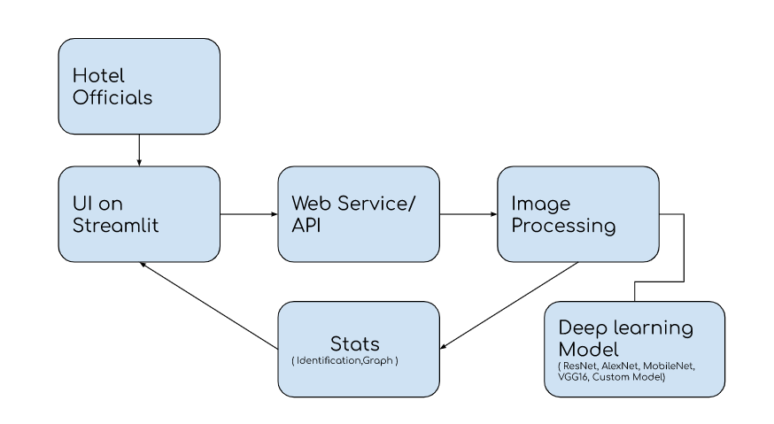
System Architecture
The system architecture allows hotel officials to interact with the system through a web service/API and a user interface.
The uploaded images are processed and classified using a deep learning model, and the results are presented back to the users through the user interface.
This architecture ensures a seamless flow of data and interactions, enabling hotel officials to easily utilize the image classification capabilities of the system.

Slide 19
System Architecture
1. Hotel Officials: The end-users of the system are hotel officials who interact with the system to upload hotel images and obtain predictions.
2. Web Service/API: This component acts as an interface for hotel officials to communicate with the system. It receives the uploaded hotel images and forwards them for further processing.
3. Image Processing: The uploaded images undergo preprocessing steps, such as resizing, normalization, and augmentation. This prepares the images to be fed into the deep learning model for classification.
4. Deep Learning Model: This component performs the classification of hotel images based on their appearance. It takes the preprocessed images as input and predicts the class or area to which each image belongs. In this case, we use, Custom model for classification.
5. User Interface (Streamlit): The user interface is built using Streamlit, a Python library for creating interactive web applications. It provides a user-friendly interface for hotel officials to upload images, trigger the prediction process, and view the predicted classes

Slide 20
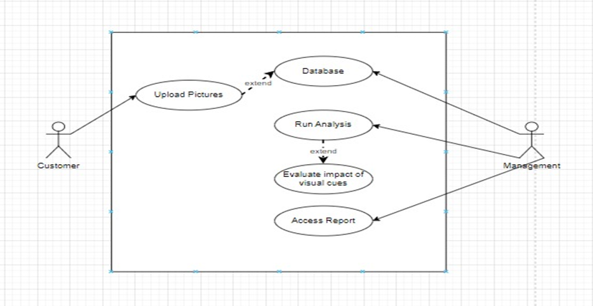
Use Case Diagram

Slide 21
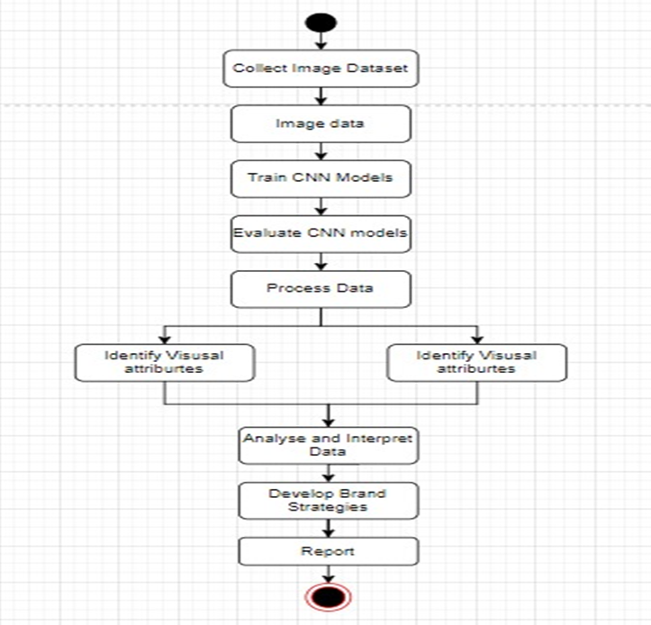
Activity Diagram

Slide 22
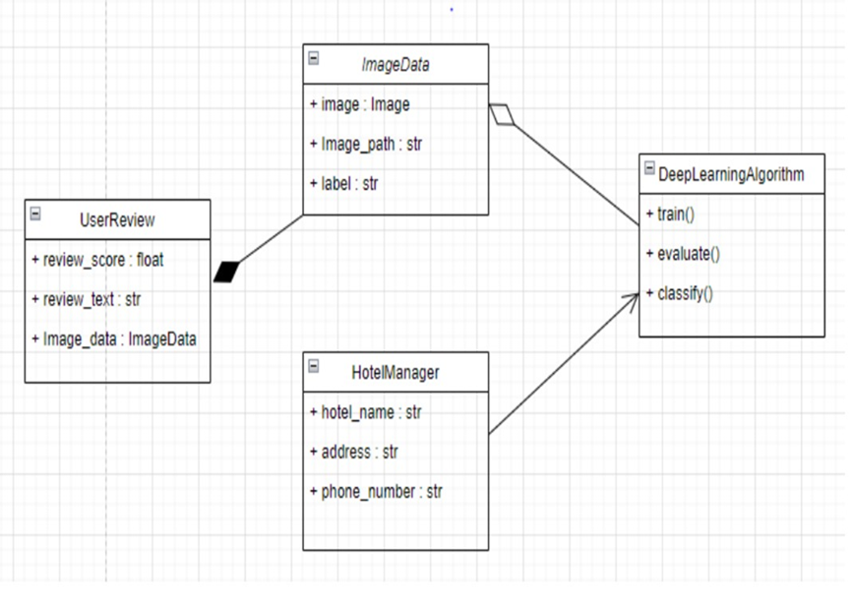
Class Diagram

Slide 23

Implementation of Project
Data Collection: In order to gather a comprehensive dataset for the project, a web scraping methodology was employed to collect data from TripAdvisor.The web scraping process involved the development of a Python script utilizing the Selenium WebDriver and related libraries. The script was designed to automate the data extraction process from the TripAdvisor website.
Data Preprocessing: In order to prepare the training data for the hotel-image classification project, a series of preprocessing steps were applied to ensure data quality and compatibility with the deep learning model like rescaling and data augmentation.

Slide 24

Models Used
1) AlexNet:
Performance: AlexNet achieved significant improvements in accuracy on benchmark datasets, outperforming traditional methods and demonstrating the potential of deep learning in image classification.
2) ResNet50:
Performance: ResNet50 achieved outstanding performance on benchmark datasets, significantly reducing the error rate compared to previous architectures. Its skip connections enable the training of very deep networks with improved accuracy and convergence.

Slide 25

Models Used
3) VGG16:
Performance: VGG16 achieved competitive performance on benchmark datasets, showcasing the importance of depth in capturing intricate image features. It provided insights into the relationship between model capacity and performance, paving the way for subsequent architectures.
4) MobileNet:
Performance: MobileNet achieves a good balance between model size and accuracy. It has demonstrated competitive performance on benchmark datasets, showcasing its efficiency compared to larger architectures.

Slide 26
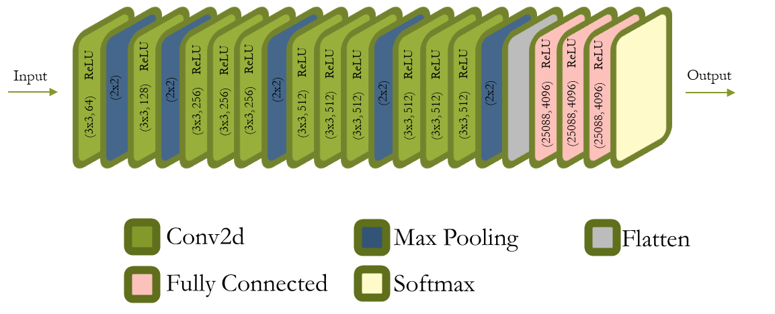
Custom Model
The architecture follows a pattern of alternating convolutional and max-pooling layers, progressively increasing the depth and abstractness of the learned features. This hierarchical representation allows the model to capture both low-level and high-level visual patterns.

Slide 27

Testing
To evaluate the performance of the model, several testing strategies were employed. These strategies aimed to assess the model's accuracy, as well as calculate metrics such as precision, recall, and F1-score
Train-Test Split: This approach ensured that the model was trained on a subset of the data and evaluated on unseen samples.
Metrics Evaluation: During training, the test accuracy was computed using the test_loader. The number of correct predictions and the total number of samples were tracked to calculate the test accuracy. The test accuracy was printed after each epoch as Test Accuracy: {accuracy_percentage}%.
Precision, Recall, and F1-Score Calculation: In the final epoch (when epoch == num_epochs - 1), precision, recall, and F1-score were calculated using the precision_score, recall_score, and f1_score functions from the sklearn.metrics module.

Slide 28

Source code
The hotel image classification model was implemented using python, leveraging the pytorch library for efficient development. The codebase followed industry best practices and adhered to a modular and scalable architecture.
The code was organized into logical modules, each responsible for specific tasks such as data preprocessing, feature extraction, model training, and prediction. This modular approach facilitated code reuse, readability, and maintainability.
To ensure code quality, the model code was thoroughly documented, including inline comments and docstrings that provided detailed explanations of functions, classes, and their inputs/outputs. This aided in better understanding and collaboration among developers.

Slide 29
Ethics
Ethical considerations were of utmost importance throughout the development of the hotel image classification model.
The dataset used for training the model was carefully curated to ensure diversity and representativeness.
Bias mitigation techniques such as data augmentation were employed to minimize any skewed representation of classes and improve fairness.
Transparency and explainability were prioritized by incorporating techniques such as model interpretability and feature importance analysis. This helped understand the model's decision-making process and identify potential biases.
Regular monitoring and evaluation of the model's performance were conducted to detect and rectify any biases that might arise over time.

Slide 30

Deployment
Once the model achieved satisfactory performance, it was deployed to a production environment where it can be used to classify hotel images into different categories.
Developed a user-friendly interface that allowed users to upload hotel images and receive predictions for the corresponding categories.
Continuously monitored and evaluated the model's performance in the real-world application and made improvements.

Slide 31

Future Aspects
Expansion of Classifications: While the current model provides classification into broad categories of hotel images, there is scope for expanding the classification to include more specific subcategories. This could involve identifying and classifying different types of hotel rooms, amenities, or architectural features.
Integration of User Feedback: Incorporating user feedback and reviews can significantly enhance the accuracy and relevance of the hotel-image classification model. By analyzing user sentiments and preferences expressed in reviews, the model can learn to better understand and classify hotel images based on user expectations and experiences.

Slide 32
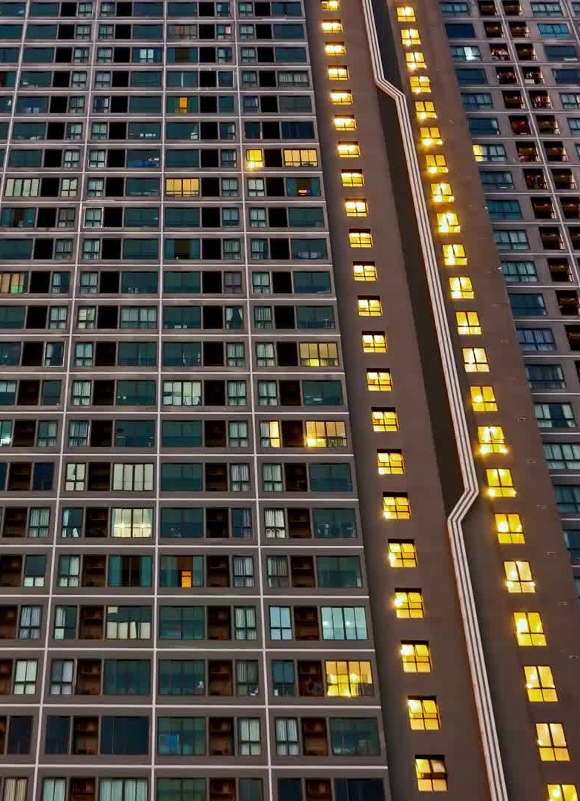
Real-Time Image Classification: The current model operates on pre-uploaded hotel images. However, there is potential to develop a real-time image classification system that can analyze hotel images on the fly. This would allow users to capture and upload images directly from their mobile devices, providing instant classification results and recommendations.
Integration with Booking Platforms: Integrating the hotel-image classification model with popular booking platforms can offer added value to users.
Continuous Model Training and Improvement: Machine learning models thrive on continuous learning and improvement. As more data becomes available and user feedback is gathered, the model can be retrained and refined to increase its accuracy and adaptability.

Slide 33
Individual Contributions
Vidushi Sharma
Aim: Model Selection and Performance Testing
Objective: 1) To study the different CNN models and test them, Train Model (ResNet)
Contribution:
Select different image classification algorithms, such as Convolutional Neural Networks (CNNs), and test their performance on the hotel image dataset.
Evaluate the effectiveness of each algorithm by measuring metrics like accuracy, precision, recall, and F1 score on the test dataset.
Choose the most effective algorithm based on its performance metrics.

Slide 34
Individual Contributions
Sahil Vakkani
Aim: Data Collection and Preprocessing
Objective: 1) To collect the required data
2) To preprocess the collected data. Train Model (AlexNet)
Contribution:
Collect a large dataset of hotel images with labels for different categories such as lobby, guest room, restaurant, pool, etc. This dataset will be used for training and evaluating the model.
Preprocess the dataset by resizing the images to a consistent resolution, normalizing pixel values, and applying any necessary transformations or augmentations. Split the dataset into training and testing subsets

Slide 35
Individual Contributions
Venkatesh Shirbhate
Aim: Model Development and Training
Objective: 1) To develop and train the model (MobileNet, VGG16, Custom(shared))
Contribution:
Based on the selected algorithm and feature analysis results, develop a model architecture suitable for hotel image classification.
Train the model using the preprocessed dataset, considering the appropriate loss function, optimizer, and learning rate.
Monitor the training process and adjust the hyperparameters if needed to improve model performance.

Slide 36
Individual Contributions
Adnan Nazmuddin
Aim: Model Deployment and Application
Objective: 1) To deploy the customized model (custom shared)
2) To develop User friendly Application (StreamLit)
Contribution:
Once the model achieves satisfactory performance, deploy it to a production environment where it can be used to classify hotel images into different categories.
Develop a user-friendly interface or application that allows users to upload hotel images and receive predictions for the corresponding categories.
Continuously monitor and evaluate the model's performance in the real-world application and make improvements as necessary.

Slide 37

Thankyou

